Slide 1
Presentation on Sequential Logic
Course Title: Digital Logic Design
Presented by
Israt Jahan Reshma
ID: 18ICTCSE041
Student of SHIICT,BSMRSTU

Slide 2
1. Design of a sequential circuit with two JK flip-flops and one input, x. When x = 0, the state of the circuit remains the same. When x = 1, the circuit goes through the state transitions from00 to 01 to 11 to 10 back to 00, and repeats.
Soln:
Present State |  | Next State
 |  | X=0 |  | X=1
A | B | A | B | A | B
O | 0 | 0 | 0 | 0 | 1
0 | 1 | 0 | 1 | 1 | 1
1 | 0 | 1 | 0 | 0 | 0
1 | 1 | 1 | 1 | 1 | 0
Here, No State are equivalent, so, State reduction is not needed.

Slide 3
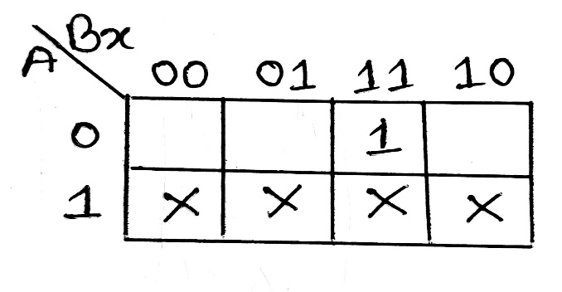
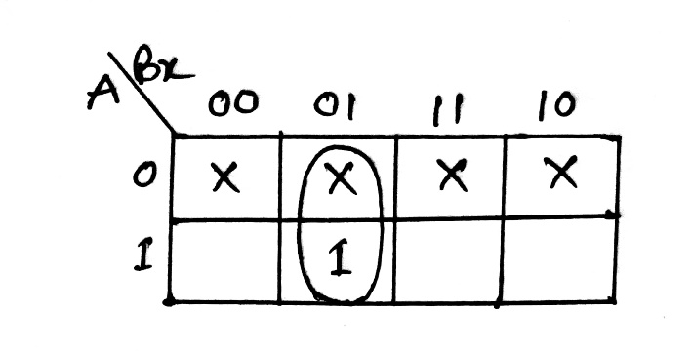
K map for JA: k map for KA:
Present State |  | Input | Next State |  | Flip Flop Input
A | B | x | A | B | JA | KA | KB | KB
0 | 0 | 0 | 0 | 0 | 0 | X | 0 | X
0 | 0 | 1 | 0 | 1 | 0 | X | 1 | X
0 | 1 | 0 | 0 | 1 | 0 | X | X | 0
0 | 1 | 1 | 1 | 1 | 1 | X | X | 0
1 | 0 | 0 | 1 | 0 | X | 0 | 0 | X
1 | 0 | 1 | 0 | 0 | X | 1 | 0 | X
1 | 1 | 0 | 1 | 1 | X | 0 | X | 0
1 | 1 | 1 | 1 | 0 | X | 0 | X | 1
JA = Bx
KA = B’x

Slide 4
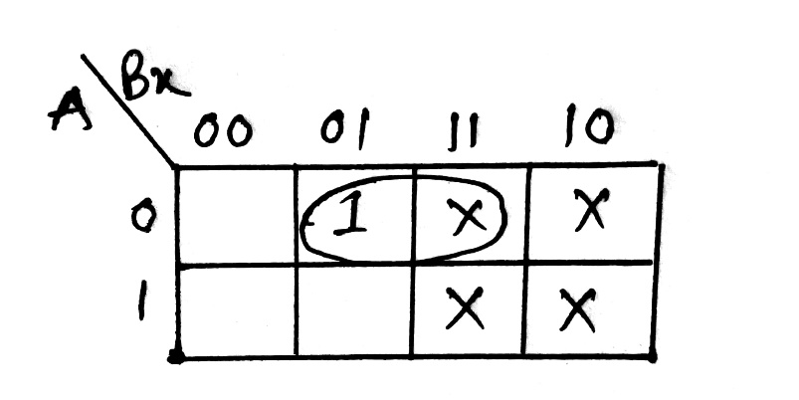
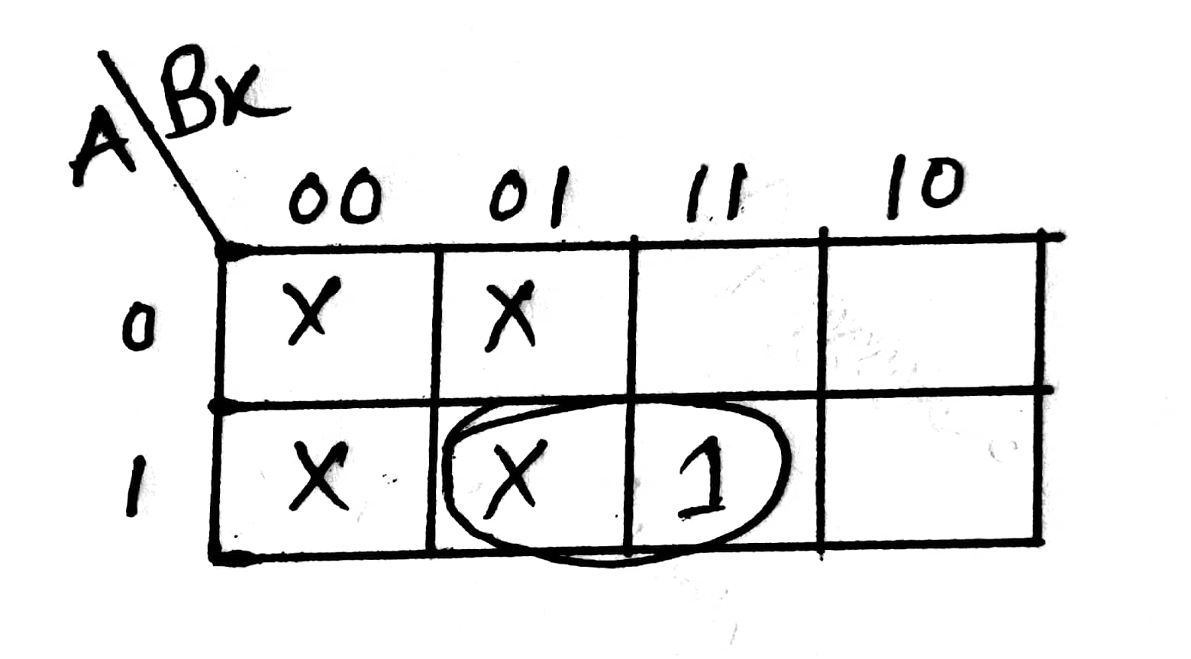
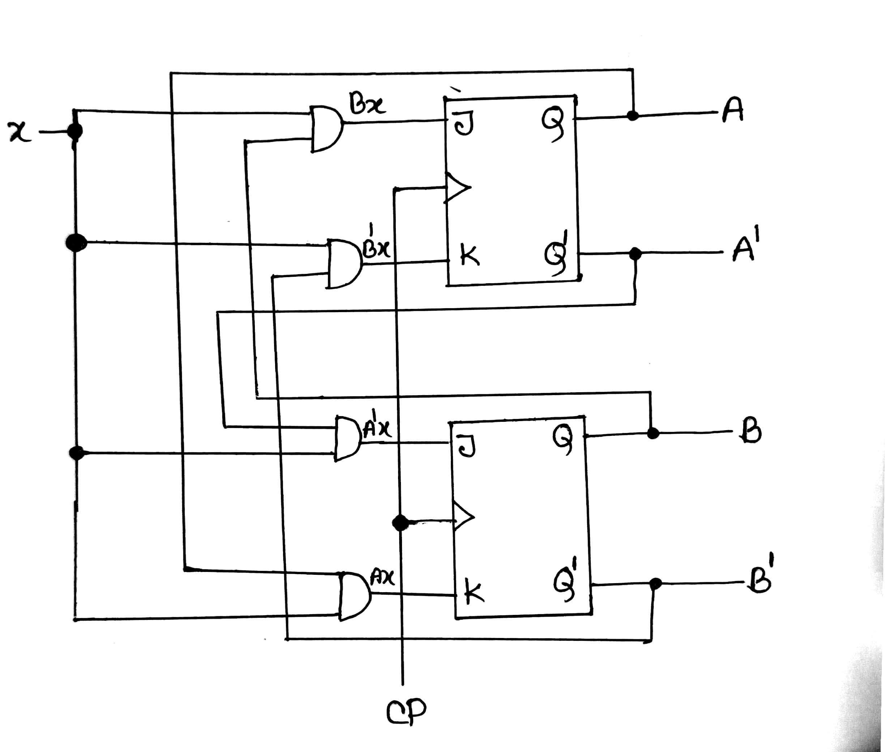
K map for JB
K map for KB
JB = A’x
KB= Ax
The Logic Diagram:

Slide 5
2. Design of a counter with the following repeated binary sequence: 0, 1, 2, 4, 6 using JK flip-flops.
Soln:
Present state |  |  | Next state |  |  | FF inputs
A | B | C | A | B | C | JA | KA | JB | KB | JC | KC
0 | 0 | 0 | 0 | 0 | 1 | 0 | X | 0 | X | 1 | X
0 | 0 | 1 | 0 | 1 | 0 | 0 | X | 1 | X | X | 1
0 | 1 | 0 | 1 | 0 | 0 | 1 | X | X | 1 | 0 | X
0 | 1 | 1 | X | X | X | X | X | X | X | X | X
1 | 0 | 0 | 1 | 1 | 0 | X | 0 | 1 | X | 0 | X
1 | 0 | 1 | X | X | X | X | X | X | X | X | X
1 | 1 | 0 | 0 | 0 | 0 | X | 1 | X | 1 | 0 | X
1 | 1 | 1 | X | X | X | X | X | X | X | X | X

Slide 6
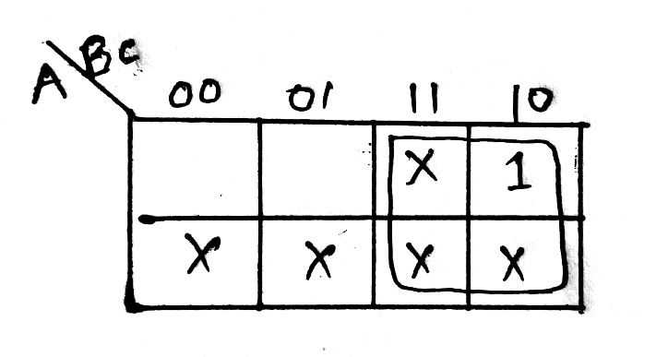
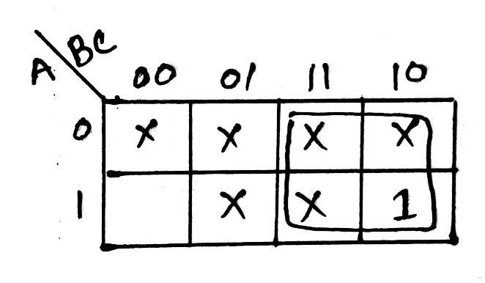
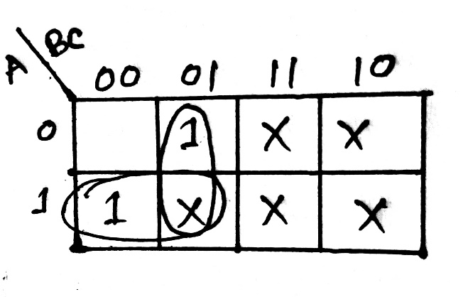
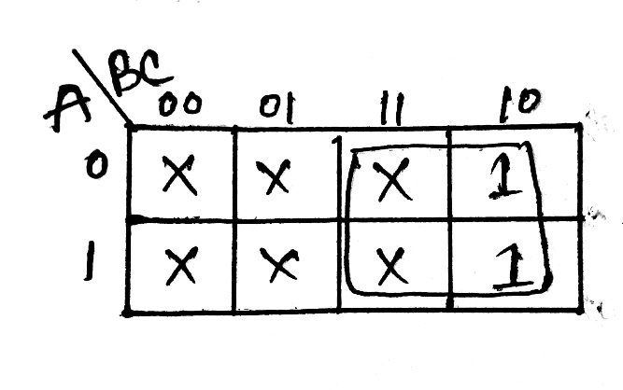
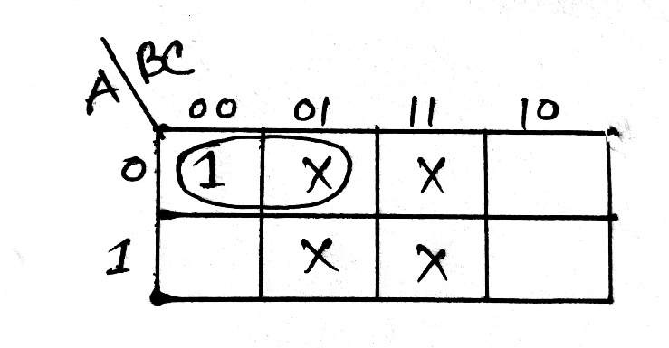
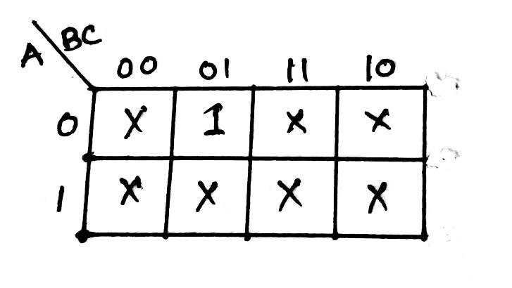
K map for JA
K map for KA
K map for JB
JA=B
KA=B
JB=AB’+B’C=B’(A+C)
K map for KB
K map for JC
K map for KC
KB=B
JC=A’B’
KC=1

Slide 7
For unused steps:
Now we find A(t+1), B(t+1),C(t+1) from the equation of JA,KA,JB,KB,JC,KC.
we know,
A(t+1)=AK’+A’J
B(t+1)=BK’+B’J
C(t+1)=CK’+C’J
Present state |  |  | Next state |  |  | FF inputs
A | B | C | A(t+1) | B(t+) | C(t+1) | JA | KA | JB | KB | JC | KC
0 | 1 | 1 | 1 | 0 | 0 | 1 | 1 | 0 | 1 | 0 | 1
1 | 0 | 1 | 1 | 1 | 0 | 0 | 0 | 1 | 0 | 0 | 1
1 | 1 | 1 | 0 | 0 | 0 | 1 | 1 | 0 | 1 | 0 | 1

Slide 8
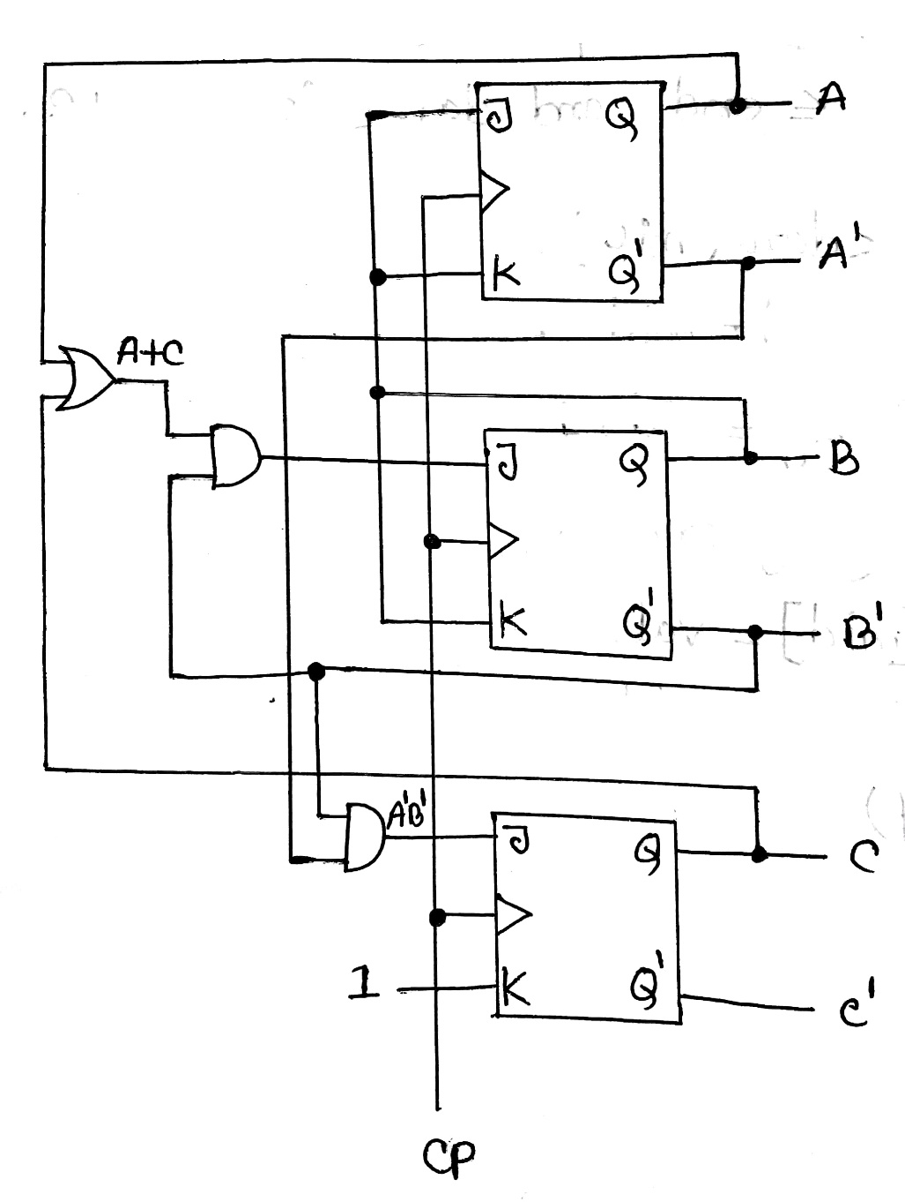
The Logic Diagram:

Slide 9
3. Design of a counter with the following repeated binary sequence: 0, 1, 3, 7, 6, 4 using T flip-flops.
Soln:
Present State |  |  | Next State |  |  | Flip Flop Inputs
A | B | C | A(t+1) | B(t+1) | C(t+1) | TA | TB | TC
0 | 0 | 0 | 0 | 0 | 1 | 0 | 0 | 1
0 | 0 | 1 | 0 | 1 | 1 | 0 | 1 | 0
0 | 1 | 0 | X | X | X | X | X | X
0 | 1 | 1 | 1 | 1 | 1 | 1 | 0 | 0
1 | 0 | 0 | 0 | 0 | 0 | 1 | 0 | 0
1 | 0 | 1 | X | X | X | X | X | X
1 | 1 | 0 | 1 | 0 | 0 | 0 | 1 | 0
1 | 1 | 1 | 1 | 1 | 0 | 0 | 0 | 1

Slide 10
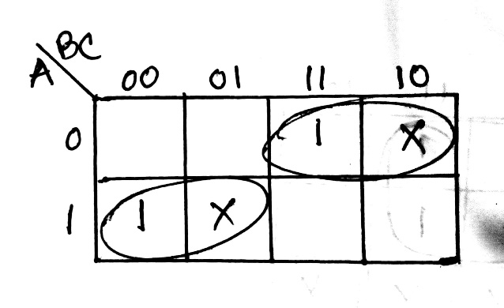
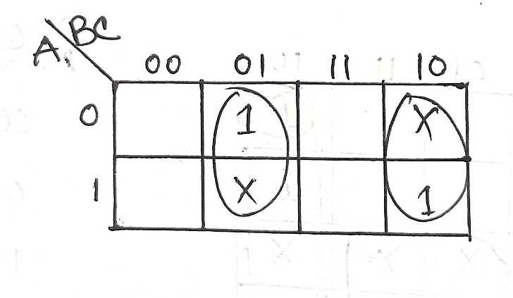
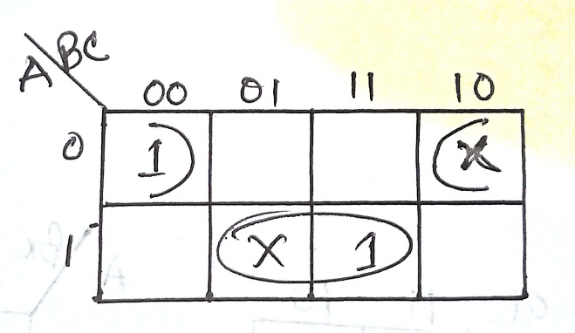
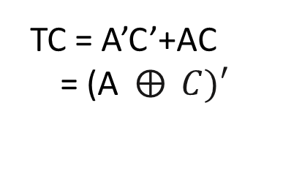
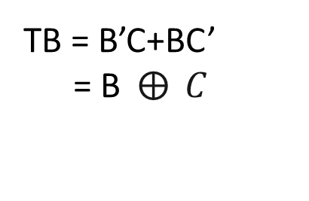
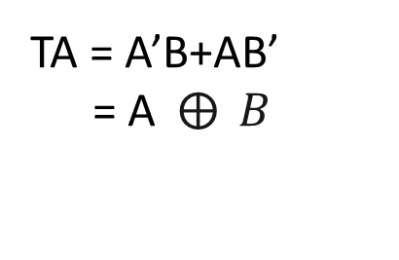
For unused steps: Now we find A(t+1), B(t+1),C(t+1) from the equation of TA,TB,TC. we know, A(t+1)=TA’+T’A B(t+1)=TB’+T’B C(t+1)=TC’+T’C
K map for TA
K map for TB
K map for TC
TA = A’B+AB’
= A$⨁{ }B$
TB = B’C+BC’
= B$⨁{ }C$
TC = A’C’+AC
= (A$⨁{ }C)′$
Present State |  |  | Next State |  |  | Flip Flop Inputs
A | B | C | A(t+1) | B(t+1) | C(t+1) | TA | YB | TC
0 | 1 | 0 | 1 | 0 | 1 | 1 | 1 | 1
1 | 0 | 1 | 0 | 1 | 0 | 1 | 1 | 1

Slide 11
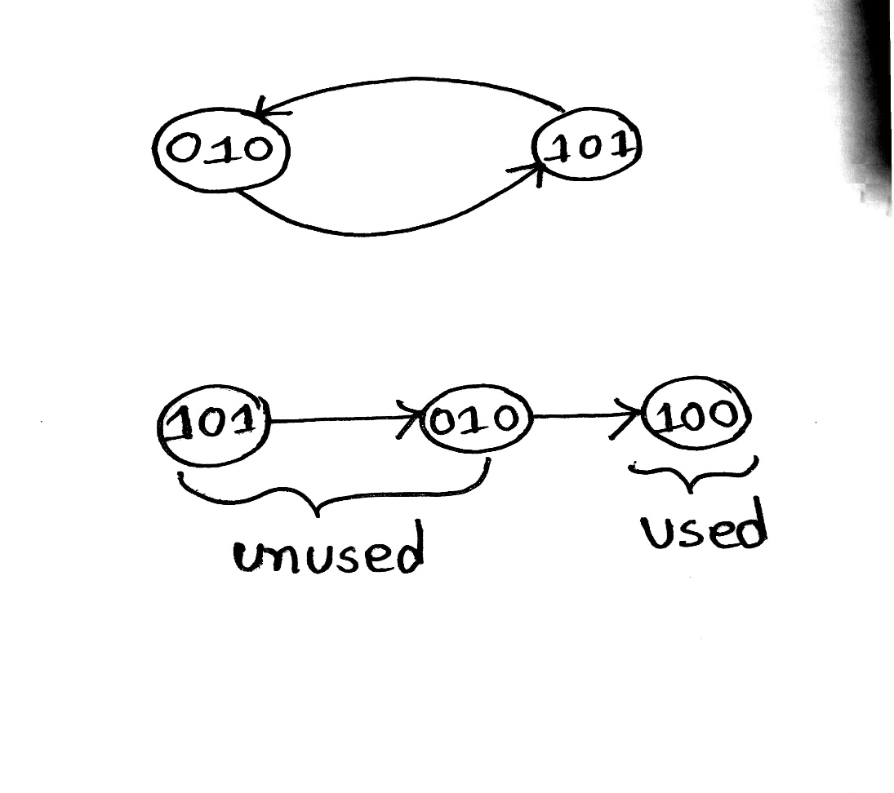
State Diagram:
Lock out problem
To solve this problem ,let us assume the following diagram
State Table After correction:
Present State |  |  | Next State |  |  | Flip Flop Inputs
A | B | C | A(t+1) | B(t+1) | C(t+1) | TA | YB | TC
0 | 0 | 0 | 0 | 0 | 1 | 0 | 0 | 1
0 | 0 | 1 | 0 | 1 | 1 | 0 | 1 | 0
0 | 1 | 0 | 1 | 0 | 0 | 1 | 1 | 0
0 | 1 | 1 | 1 | 1 | 1 | 1 | 0 | 0
1 | 0 | 0 | 0 | 0 | 0 | 1 | 0 | 0
1 | 0 | 1 | 0 | 1 | 0 | 1 | 1 | 1
1 | 1 | 0 | 1 | 0 | 0 | 0 | 1 | 0
1 | 1 | 1 | 1 | 1 | 0 | 0 | 0 | 1

Slide 12
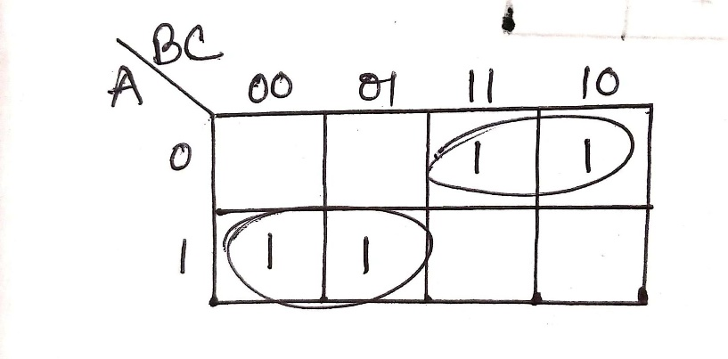
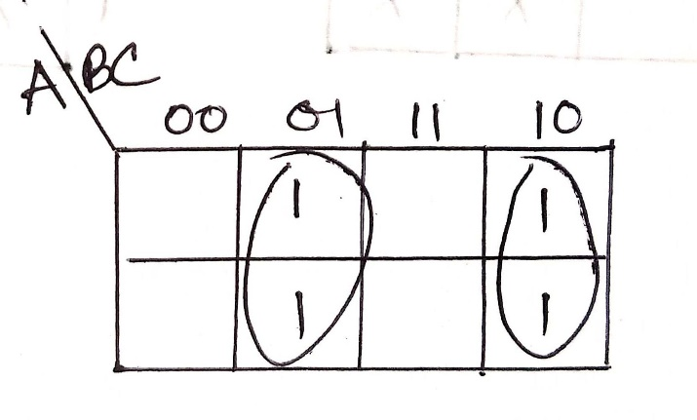
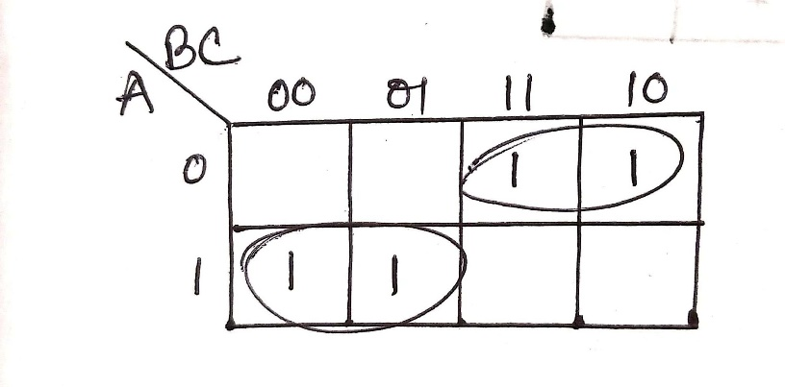
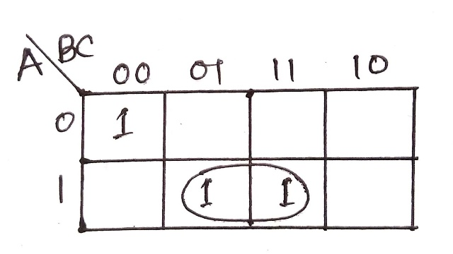
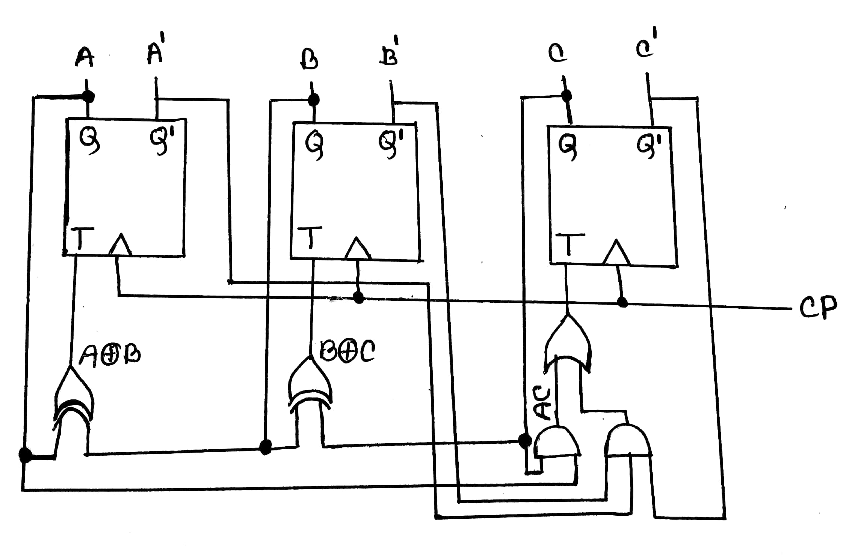

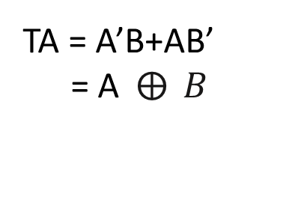
K map for TA
K map for TB
K map for TC
TA = A’B+AB’
= A$⨁{ }B$
TB = B’C+BC’
= B$⨁{ }C$
TC = A’B’C’+AC
The Logic Diagram:

Slide 13
4. To reduce the number of the states in the following state table and tabulate the reduced state table.
present state | next state |  | output
 | x=0 | x=1 | x=0 | x=1
a | f | b | 0 | 0
b | d | c | 0 | 0
c | f | e | 0 | 0
d | g | a | 1 | 0
e | d | c | 0 | 0
f | f | b | 1 | 1
g | g | h | 0 | 1
h | g | a | 1 | 0

Slide 14
present state | next state |  | output
 | x=0 | x=1 | x=0 | x=1
a | f | b | 0 | 0
b | d | c=a | 0 | 0
c | f | e=b | 0 | 0
d | g | a | 1 | 0
e | d | c | 0 | 0
f | f | b | 1 | 1
g | g | h=d | 0 | 1
h | g | a | 1 | 0
l
×
(c=a)
×
(e=b)
×
(h=d)

Slide 15
Reduced State Table:
present state | next state |  | output
 | x=0 | x=1 | x=0 | x=1
a | f | b | 0 | 0
b | d | a | 0 | 0
d | g | a | 1 | 0
f | f | b | 1 | 1
g | g | d | 0 | 1

Slide 16
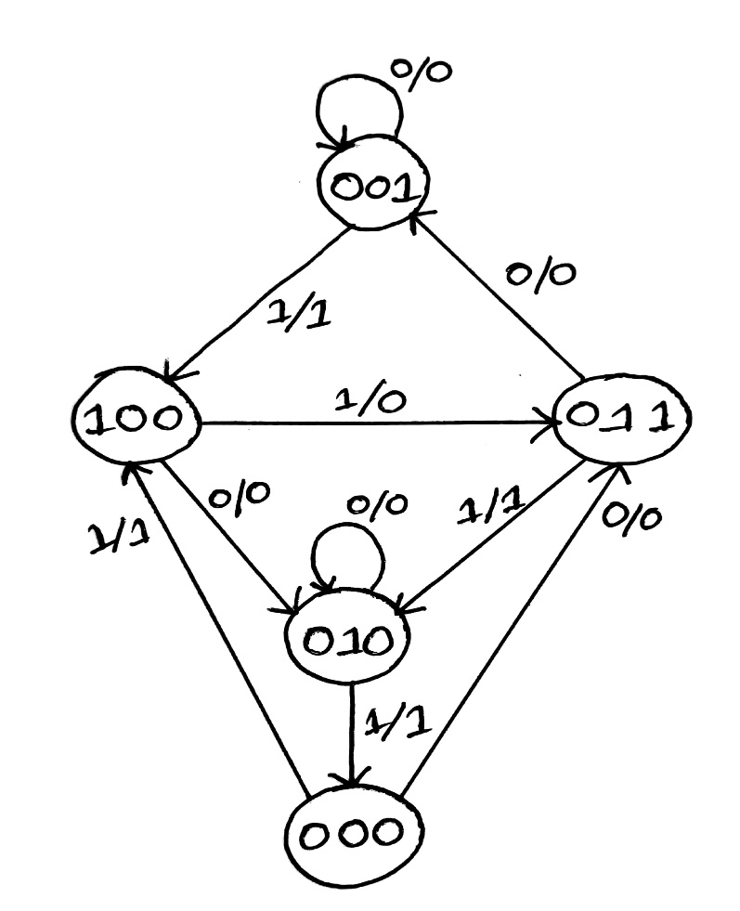
5. Design of a sequential circuit that has three D flip-flops A, B, C; one input, x and one output, y using the following state diagram
The State Table:
Soln:
Present State |  |  | Input | Next State |  |  | output
A | B | C | x | A(t+1) | B(t+1) | C(t+1) | y
0 | 0 | 0 | 0 | 0 | 1 | 1 | 0
0 | 0 | 0 | 1 | 1 | 0 | 0 | 1
0 | 0 | 1 | 0 | 0 | 0 | 1 | 0
0 | 0 | 1 | 1 | 1 | 0 | 0 | 1
0 | 1 | 0 | 0 | 0 | 1 | 0 | 0
0 | 1 | 0 | 1 | 0 | 0 | 0 | 1
0 | 1 | 1 | 0 | 0 | 0 | 1 | 0
0 | 1 | 1 | 1 | 0 | 1 | 0 | 1
1 | 0 | 0 | 0 | 0 | 1 | 0 | 0
1 | 0 | 0 | 1 | 0 | 1 | 1 | 0

Slide 17
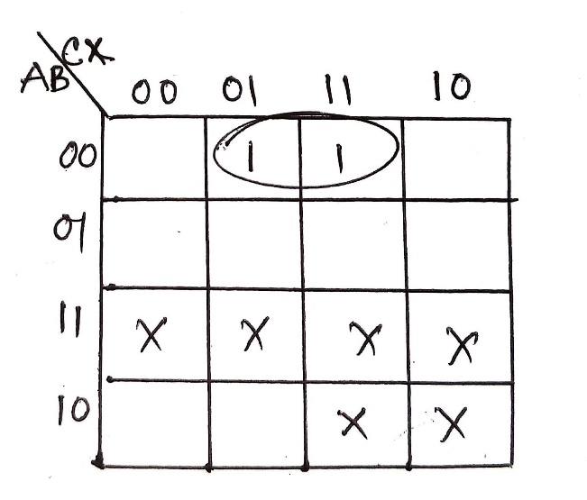
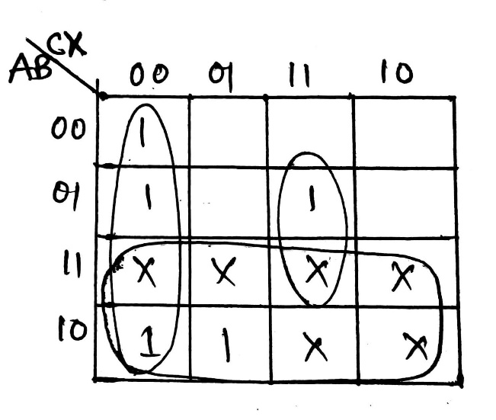
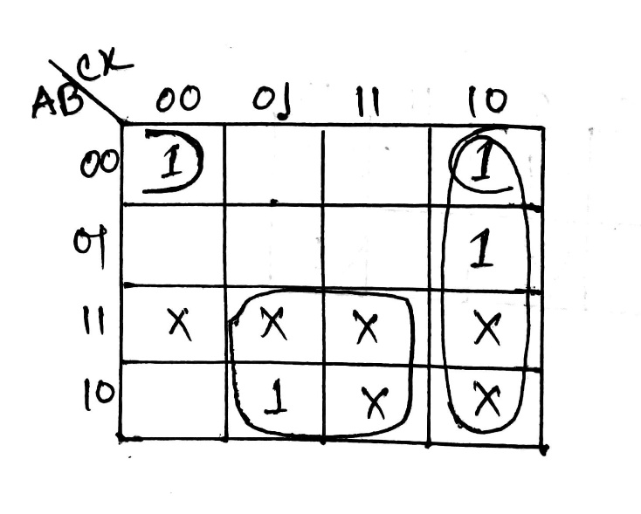
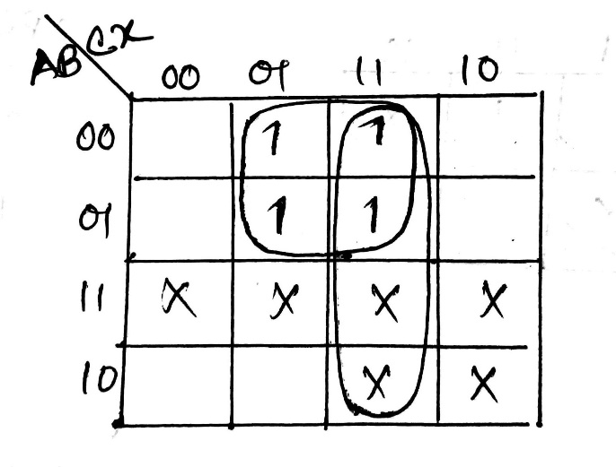
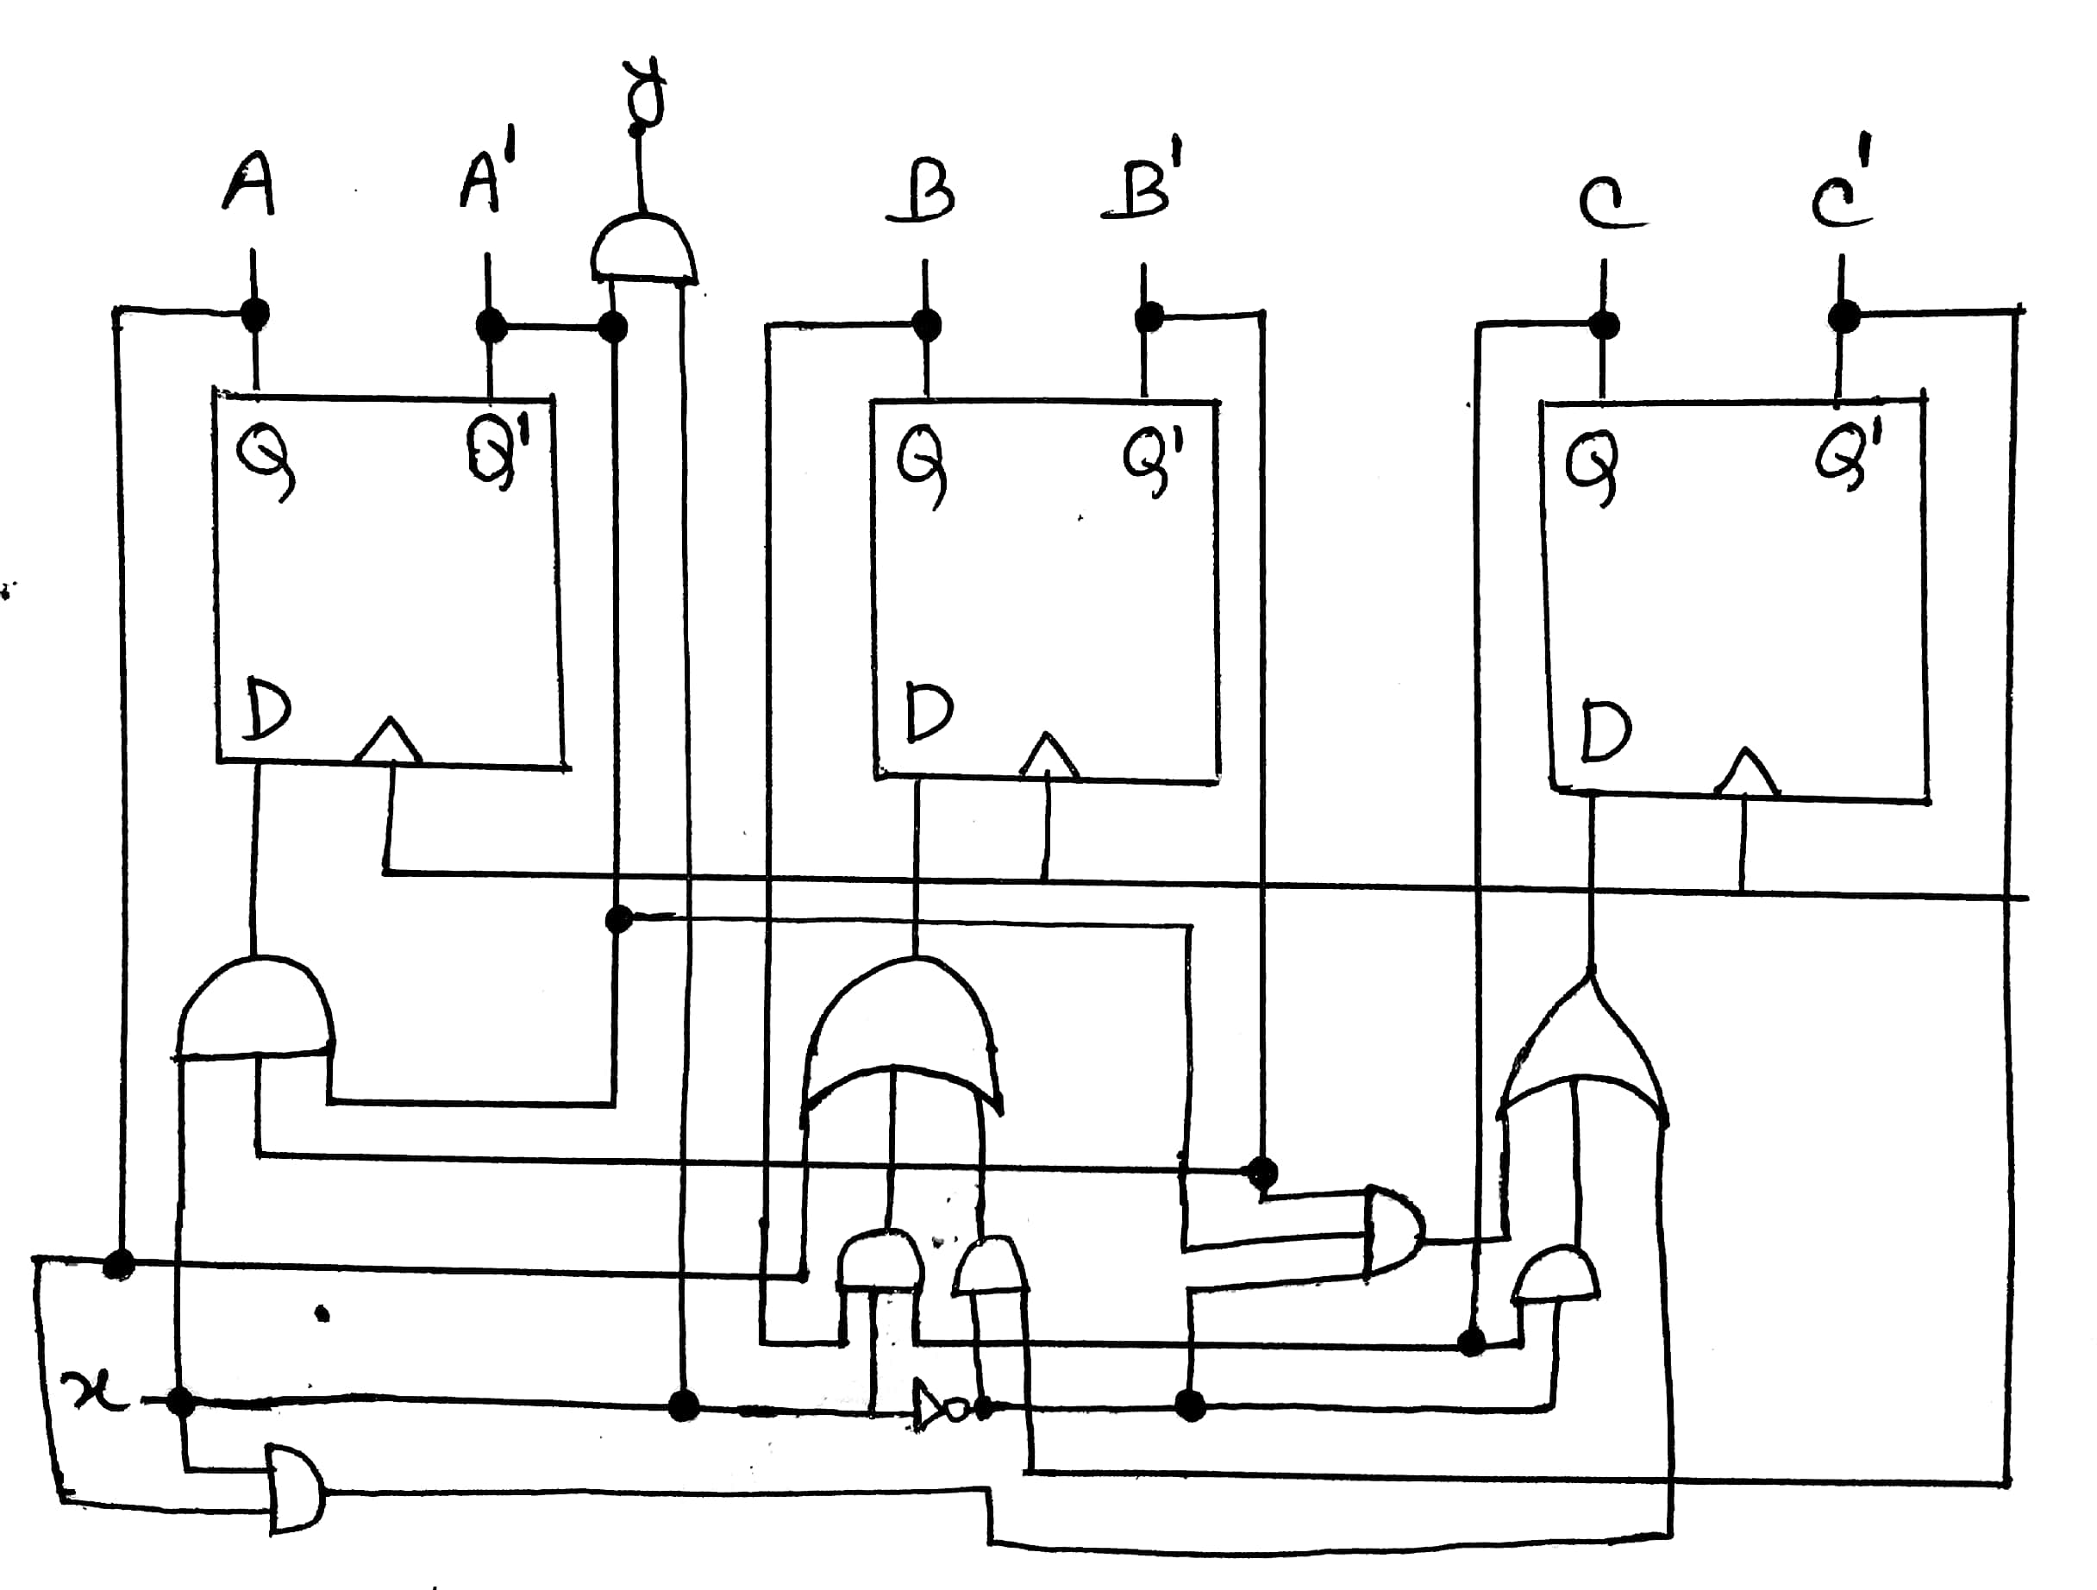
don’t care, d(A,B,C,x) = Ʃ(10,11,12,13,14,15)
K map for A(t+1)
K map for B(t+1)
K map for C(t+1)
K map for y
A(t+1)= A’B’x
B(t+1)= C’x’+A+BCx
C(t+1)= A’B’x’+Cx’+Ax
y= A’x
The Logic Diagram:

Slide 18
Thank You

